Slide 1
HOTEL BOOKING SYSTEM USING JSP
SHIVRAM U (2112088)
DHARUN RAM K (2112118)

Slide 2
Table of contents
01
02
03
INTRODUCTION
ABSTRACT
TECHNOLOGY USED
04
05
06
SOFTWARE USED
IMPLEMENTATION
CONCLUSION

Slide 3
01
INTRODUCTION

Slide 4
INTRODUCTION
A hotel booking system, or hotel reservation software, is a technology platform that enables hoteliers to accept direct bookings through the hotel’s website and through various distribution channels.

Slide 5
02
ABSTRACT

Slide 6
ABSTRACT
The Hotel Booking System is a project implemented for Hail Hotel, which is an imaginary hotel. It provides people all over the world with an easy and fast way to book hotel rooms online. The interface of the Hotel Booking System is Web pages that can be accessed with a Web site browser. The system is implemented using JSP with database connectivity using MySQL.

Slide 7
03
TECHNOLOGY USED

Slide 8





TECHNOLOGY USED
JSP
Java Server Page
HTML
JS
Hyper Text Markup Language
JavaScript
CSS
MYsql
Cascading Style Sheets
My Structured Query Language

Slide 9
04
SOFTWARE
USED

Slide 10



SOFTWARE USED
VISUAL STUDIO CODE
PHPMYADMIN
XAMPP
For Frontend
For Backend
Server

Slide 11
05
IMPLEMENTATION

Slide 12
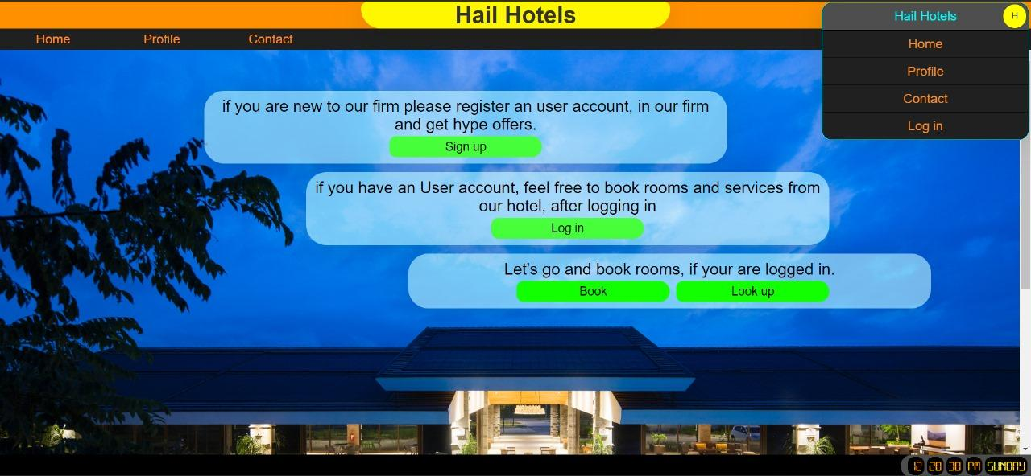
WELCOME PAGE

Slide 13
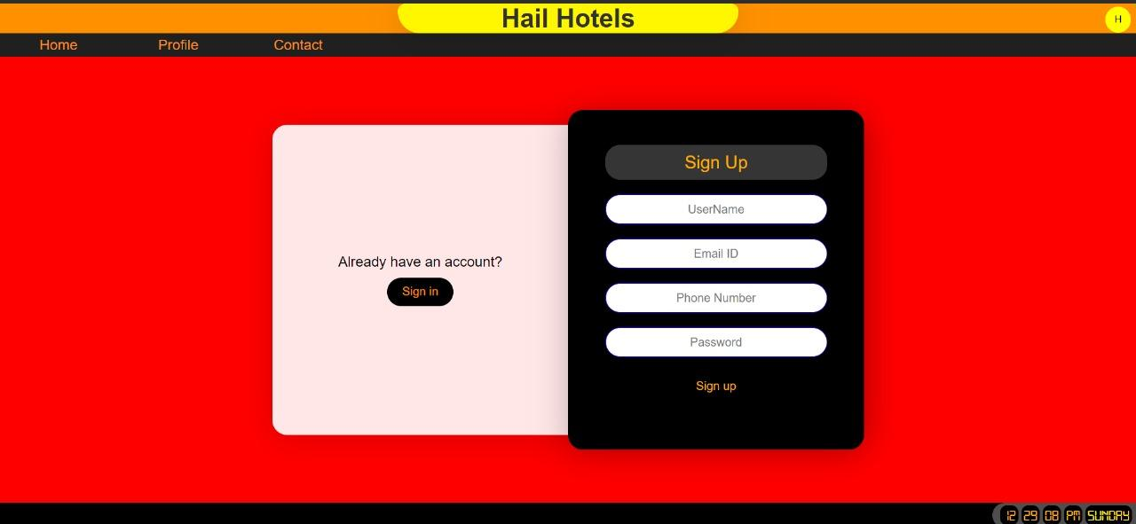
SIGNUP PAGE

Slide 14
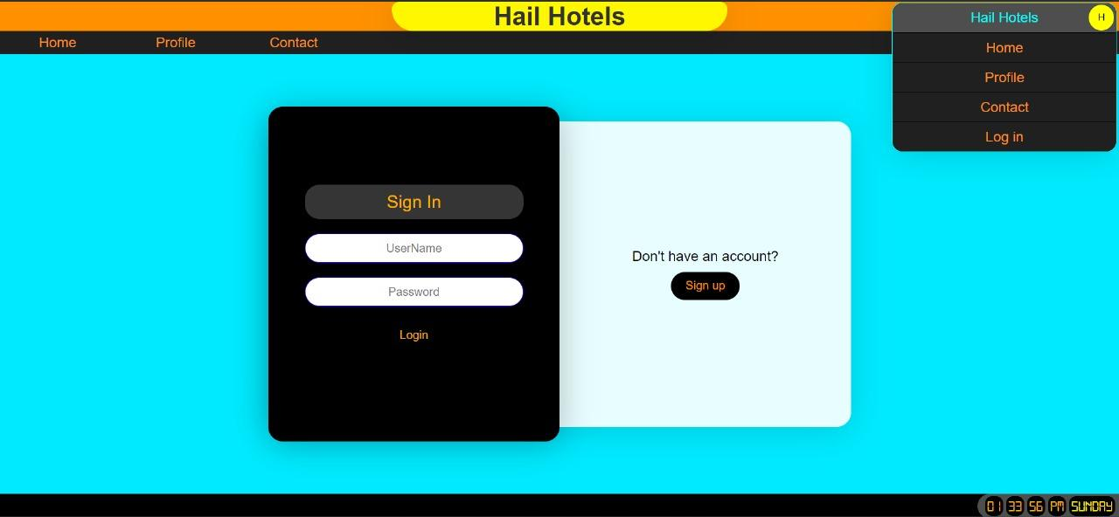
SIGIN PAGE

Slide 15
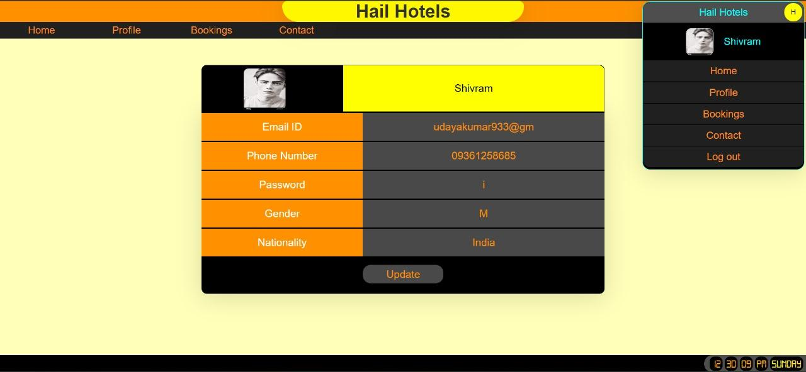
PROFILE PAGE

Slide 16
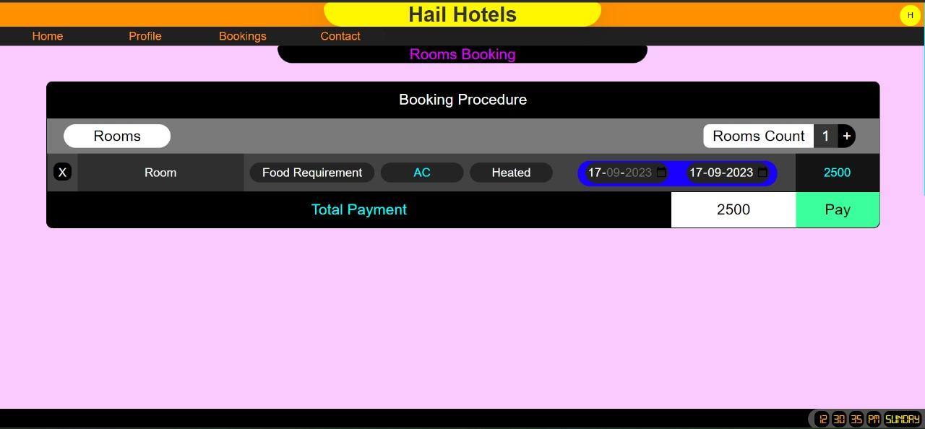
BOOKING PAGE

Slide 17
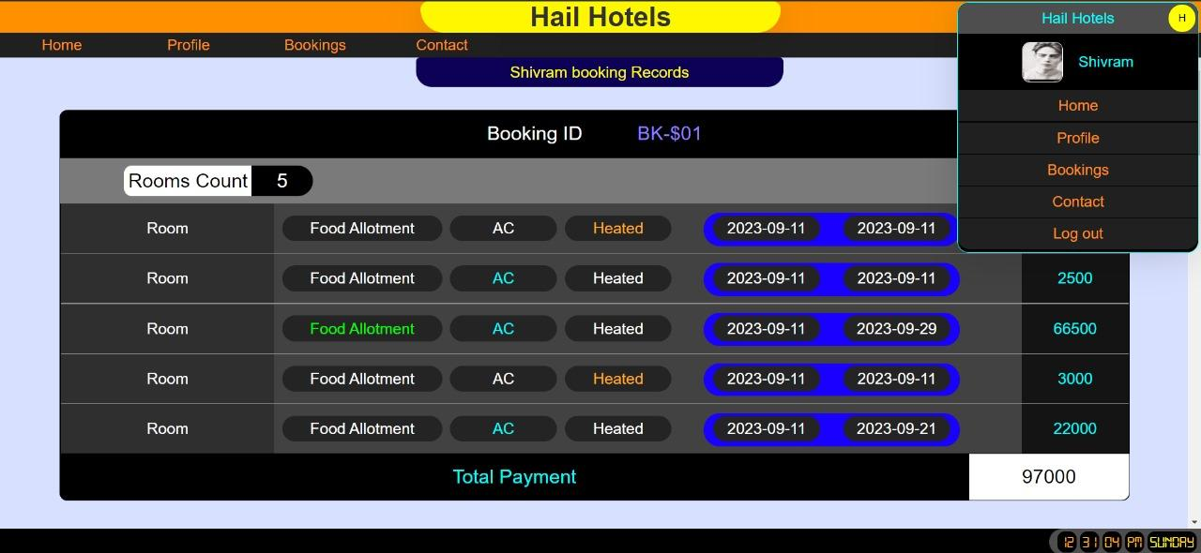
VIEW BOOKING PAGE

Slide 18
06
CONCLUSION

Slide 19
CONCLUSION
Hotel Booking System is a user-friendly and easy-to-use web-based application. Everyone who knows how to use a Web browser can register and then login to book a room, change booking details, cancel booking, and view or modify personal profile online. It is easy and fast to make a reservation.

Slide 20
THANK YOU !

